Slide 1
Analysis of Volatility Through Technical Stock Trading Strategies
By: Ronney Aovida
Goal: attempt to beat Efficient market hypothesis, compare difference between leading/lagging indicators and between stock volatility

Slide 2
Introduction
What are financial markets?
open and regulated system used by companies to obtain large amounts of financial capital to grow their businesses
What are stocks?
the capital raised by a business or corporation through the issue and subscription of shares.
Who determines its value?
Fundamental vs Technical Analysis:
Fundamental: is a method of evaluating a security to measure its intrinsic value, by examining related economic, financial and other qualitative and quantitative factors.
Technical: trading tool employed to evaluate securities and attempt to forecast their future movement by analyzing statistics gathered from trading activity, such as price movement and volume
Time frames:
Long term: hold and sell after months to a year, best for fundamental
Swing trade: opportune buyers, typically ride a trend and sell
Day trade: purchase stocks from minutes to hours at most, best for technical
Efficient Market Hypothesis: no investor should be able to beat the market. Index funds increase or decrease according to overall level of corporate profitability/losses.benchmarking.

Slide 3
Project Overview
What is a trade strategy?
Back testing?
What kind of stocks are being back tested?
What is volatility?
a statistical measure of the dispersion of returns for a given security or market index
Leveraged ETF’s: these exchange traded funds are magnifiers of their related index. For example: direxion daily finance bull 3x shares ETF, its 3x of the Russell 1000 index.
These depreciate over time due to volatility. (1+0.25)*(1-0.20)-1= 0%....x3=-30%
Long term=bad. Short term=good.
The strategies used are not custom. They have been used before. I will be using these popular strategies in a variety of approaches to find: the difference between types of indicator approaches and between volatility

Slide 4
Intro to Indicators
What are indicators? Any class of metrics whose value is derived from generic price activity in a stock or assets. Goal is to predict by finding patterns.
Types of indicators:
Leading: These indicators are meant to lead price movements. Most represent a form of price momentum over a fixed look-back period
Commodity Channel Index(CCI), Momentum, Relative Strength Index(RSI), Stochastic Oscillator and Williams %R
Lagging: Follow price action and are commonly referred to as trend following indicators. These indicators will rarely lead the price of a security. Flat lines.
exponential moving average, simple moving average, weighted moving average, variable moving average and moving average convergence/divergence (MACD)

Slide 5
The Strategies
We will be conducting 3 different strategies:
Lagging strategy
Leading strategy
RSI2 strategy

Slide 6
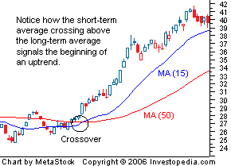
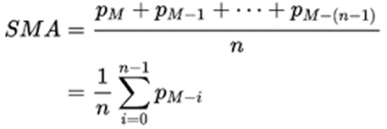
Strategy 1
What are moving averages? It is a trend following indicator. It does not predict price direction, but rather define the current direction with a lag
How they are calculated?
Influence of varied parameters. 5-35, 50-200.John Murphy.
What is the moving average crossover strategy? Buy when fast surpasses slow, sell when slow passes fast.
Note: We will not be commission fees into account. Large hindrance that can be avoided. RH: margin lending interest and interest on any uninvited cash deposits

Slide 7
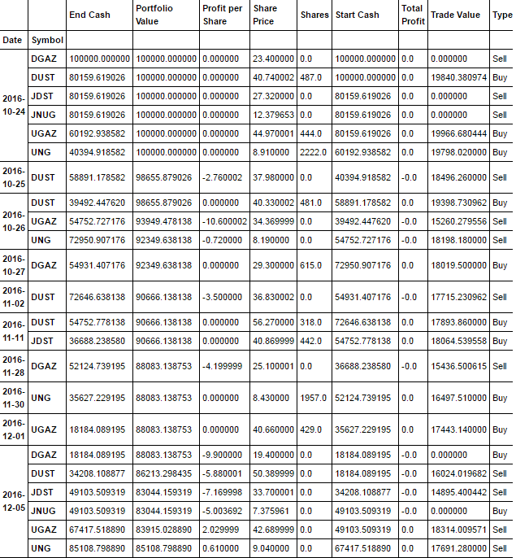

Slide 8
Strategy 1 Results
Stock:
Non-volatile: TSLA,,AAPL,GOOGL,WFC,GS,BA
Volatile ETF: JNUG,DGAZ,JDST,UGAZ,DUST,UNG
Initial investment: 100,000
Percent of portfolio to invest: 0.16 (1/(amount of stocks))
Yellow is optimal and blue is secondary
Non-volatile | Fast-5 Slow- 15 | Fast- 10 Slow- 30 | Fast- 15 Slow- 45 | Fast- 20 Slow- 60 | Fast-25 Slow-75 | Fast-30 Slow-90
2012-2013 | 9.2% | 9.6% | 1.8% | 0.3% | -2.3% | 5.2%
2013-2014 | 48% | 59.7% | 49.6% | 50.2% | 38.5% | 15.5%
2014-2015 | 5.9% | 5.9% | 0.9% | 8.8% | 4.5% | 3.3%
2015-2016 | -4.4% | 2.1% | -4.2% | 8.5% | -9.6% | -9%
2016-2017 | 22.2% | 13.3% | 5.4% | 3.9% | 3.3% | 7.5%
Volatile | Fast-5 Slow- 15 | Fast- 10 Slow- 30 | Fast- 15 Slow- 45 | Fast- 20 Slow- 60 | Fast-25 Slow-75 | Fast-30 Slow-90
2013-2014 | 24% | -14.1% | -6.2% | -16% | -15.7% | -16.9%
2014-2015 | 16.5% | -21% | -7.2% | -9.8% | -21.7% | -23%
2015-2016 | -6.1% | 15.7% | -7.9% | -9.7% | -4% | -4%
2016-2017 | -31.3% | -26.6% | -14.8% | -15.5% | -20.2% | -18%

Slide 9
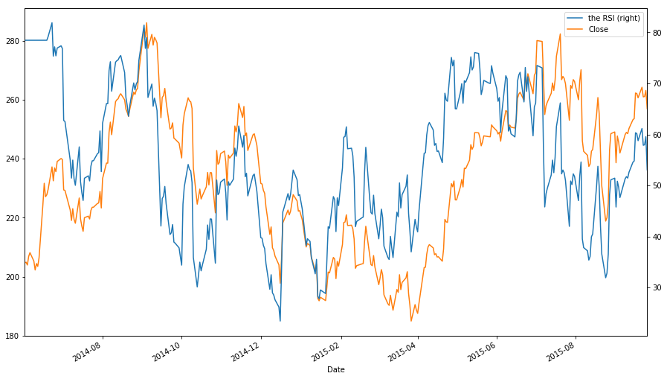
Strategy 2
What is RSI? Momentum oscillator that measures the speed and change of price movements. J. Welles Wilder. His formula normalizes rel strength into oscillator 0-100. 70-overbought.30-oversold.
Momentum Oscillators: Generally speaking, Momentum measures the rate of change of a security’s price. As the price of a security rises, price momentum increases. The faster it rises, the larger the increase in momentum. Once this rise begins to slow, momentum will also slow.

Slide 10
How its calculated
two basic components: Relive Strength, Average Gain and Average Loss (Losses will be expressed as positive values).
X=look back period.
First Average Gain= Sum of Gains over the past X periods / X
First average Loss= Sum of Losses over the past X periods/ X
Average Gain= [(previous Average Gain) x 13 + current Average Gain] / X
Average Gain= [[(previous Average Loss) x 13 + current Average Loss] / X
100
RSI = 100 - --------
1 + RS
Relative Strength = Average Gain / Average Loss

Slide 11
Influence of varied parameters
The look back period for the RSI determines the indicators sensitivity. As previously stated the 14 day period is typically the default. However if it were to be lowered to say 10 periods, the RSI will be much more likely to reach overbought or oversold levels easily
Increasing boundary gap

Slide 12
Strategy 2 Results
Stock:
Non-volatile: TSLA,,AAPL,GOOGL,WFC,GS,BA
Volatile ETF: JNUG,DGAZ,JDST,UGAZ,DUST,UNG
Initial investment: 100,000
Percent of portfolio to invest: 0.16 (1/(amount of stocks))
Yellow is most optimal and blue is secondary

Slide 13
Look Back Period | High- 95 Low-5 | High-90 Low-10 | High-85 Low- 15 | High-80 Low-20 | High-75 Low-25 | High-70 Low-30 | High-65 Low-35
LBP- 2 2016-2017 2015-2016 2014-2015 | 11.9% 18.9% 15.3% | 10.9% 18.1% 11.6% | 12.3% 22.3% 11.7% | 10.8% 21.8% 11% | 11.7% 18.5% 7.9% | 12.2% 18.8% 7.8% | 13% 15.4% 5.2%
LBP-4 2016-2017 2015-2016 2014-2015 | 2.7% 0 2% | 9.8% 3.9% 3.5% | 14% 6.4% 7.4% | 11.9% 9% 10.4% | 8.2% 15.6% 10.7% | 5% 16.5% 15.3% | 2.9% 13.8% 10.5%
LBP-6 2016-2017 2015-2016 2014-2015 | 0 0 0 | 1.3% 0 0 | 15.5% 0.7% 1.2% | 9.6% 1.9% 8.1% | 9.7% 10% 6% | 9.9% 7.7% 7.4% | 3.2% 15% 15.4%
LBP-8 2016-2017 2015-2016 2014-2015 | 0 0 0 | 0 0 0 | 10% 0 3% | 17.2% 1.8% 0.6% | 8.1% 4.7% 6% | 11.2% 9.5% 9.6% | 8.9% 5.9% 6.2%
LBP-10 2016-2017 2015-2016 2014-2015 | 0 0 0 | 0 0 0 | 0 0 0 | 12.4% 0 1% | 13% 5% 2.8% | 8.8% 4.2% 8.5% | 9.7% 7.7% 7.2%
LBP-12 2016-2017 2015-2016 2014-2015 | 0 0 0 | 0 0 0 | 0 0 0 | 9% 0 0 | 11.6% 0 0.4% | 10.7% 2% 0.9% | 10.1% 9.2% 8.2%
LBP-14 2016-2017 2015-2016 2014-2015 | 0 0 0 | 0 0 0 | 0 0 0 | 0 0 0 | 10.5% 0 0.5% | 10.3% 1.9% 3.1% | 11% 3.6% 7.7%
LBP-16 2016-2017 2015-2016 2014-2015 | 0 0 0 | 0 0 0 | 0 0 0 | 0 0 0 | 9. 4% 0 0 | 8.6% 0 0.9% | 10.4% 1.4% 1.1%

Slide 14
Look Back Period | High- 95 Low-5 | High-90 Low-10 | High-85 Low- 15 | High-80 Low-20 | High-75 Low-25 | High-70 Low-30 | High-65 Low-35
LBP- 2 2016-2017 2015-2016 2014-2015 | 0.6% 14% -6.7% | -17.8% 24% 0.1% | -38% 8.3% -2.6% | -42.5% -3.1% -4.3% | -25.4% -0.2% 2.9% | -24.7% 18.2% -3.4% | -7.8% -8.1% -25%
LBP-4 2016-2017 2015-2016 2014-2015 | 98.1% 0% 5.8% | -46.7% -16.2% -15.5% | -52.3% 13.2% -37.8% | -21.2% -1.5% -13.4% | 4.2% 6.3% -23.2% | -23.2% 1.3% -17.1% | -28% -9.7% -5%
LBP-6 2016-2017 2015-2016 2014-2015 | 0 0 0 | 0 0 0 | -7.4% 0 27.5% | -47.5% -12.4% -12.1% | -46.2% 1.5% -35% | 5.4% -6% -22.6% | -13.1% 6.3% -37.8%
LBP-8 2016-2017 2015-2016 2014-2015 | 0 0 0 | 0 0 0 | 0 0 0 | -31.7% 0 13.2% | -43.1% 31.7% -11.2% | -54% -4% -39% | -27.8% -16.2% -22.3%
LBP-10 2016-2017 2015-2016 2014-2015 | 0 0 0 | 0 0 0 | 0 0 0 | -7.3% 0 25% | -30% 0% 11.1% | -50% 18.1% -9.7% | -43.1% 5.7% -25.8%
LBP-12 2016-2017 2015-2016 2014-2015 | 0 0 0 | 0 0 0 | 0 0 0 | 0 0 0 | 14% 0 17% | -17.6% 11.5% 0.4% | -42.8% 9.5% -28%
LBP-14 2016-2017 2015-2016 2014-2015 | 0 0 0 | 0 0 0 | 0 0 0 | 0 0 0 | 0 0 0 | -26.3% 0 13% | -41.1% 10% -11.4%
LBP-16 2016-2017 2015-2016 2014-2015 | 0 0 0 | 0 0 0 | 0 0 0 | 0 0 0 | 0 0 0 | -24.7% 0 16.3% | -35.7% 8.8% -6.5%

Slide 15
Strategy 3
What is RSI2?
developed by Larry Conners as a mean-revision trading strategy designed to buy or sell securities after a corrective period
Consists of 2 moving averages and Relative Strength Index.
one very slow MA and one fast MA.
Larry Conners created this as a short term trade strategy. This is not using commission fees, so this should be very useful for all time frames.
His recommended parameters for the RSI is to use a look back period of 2 (hence the name) and boundaries of 95 and 5.

Slide 16
Strategy 3 Results
Stock:
Non-volatile: TSLA,,AAPL,GOOGL,WFC,GS,BA
Volatile ETF: JNUG,DGAZ,JDST,UGAZ,DUST,UNG
Starting amount: $100,000 Amount invested per trade: 0.16 (1/number of stocks)
Non-Volatile Stocks | MA 5/15 | MA 10/30 | MA15/45
LBP 2 95-5 2013-2014 2014-2015 2015-2016 2016-2017 | 13.4% 19% 12.7% 19% | 9.2% 20.1% 14.5% 12.7% | 6.9% 17.8% 9.4% 7.1%
LBP 4 75-25 2013-2014 2014-2015 2015-2016 2016-2017 | 18.4% 12.8% 7.5% 13.9% | 16.7% 13.3% 10% 9.8% | 13.9% 8.4% 9.4% 7.8%
LBP 6 75-25 2013-2014 2014-2015 2015-2016 2016-2017 | 13.5% 10% 7.9% 13.5% | 8.6% 11.3% 7.7% 13.6% | 13.4% 7.2% 3.9% 11%
Volatile Stocks | MA 5/15 | MA 10/30 | MA15/45
LBP 2 95-5 2013-2014 2014-2015 2015-2016 2016-2017 | 4.3% 14.6% -2.7% -17% | 1.6% -5.2% 3% 23.5% | 2.2% -12.5% -17.7% -20.1%
LBP 4 75-25 2013-2014 2014-2015 2015-2016 2016-2017 | -1.4% 20.6% 3.9% 27.3% | -2.3% -24% 19.5% -10.8% | 5.3% -22.5% -21% -24%
LBP 6 75-25 2013-2014 2014-2015 2015-2016 2016-2017 | 30% -23% -4.7% -44.2% | 2.2% -33.1% 17.3% -42.4% | 11.7% -25% -19.4% -52.4%

Slide 17
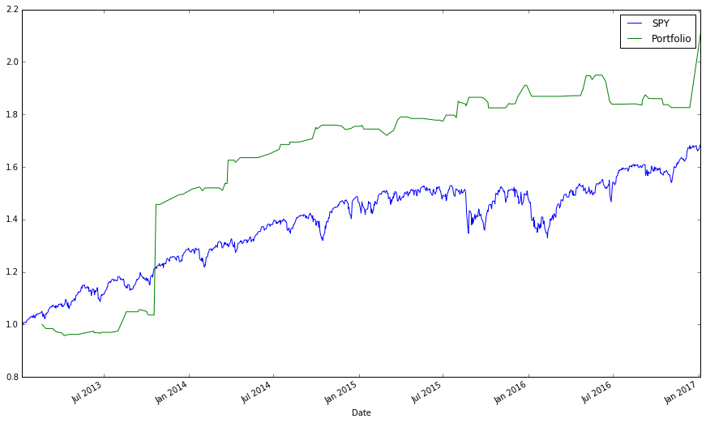
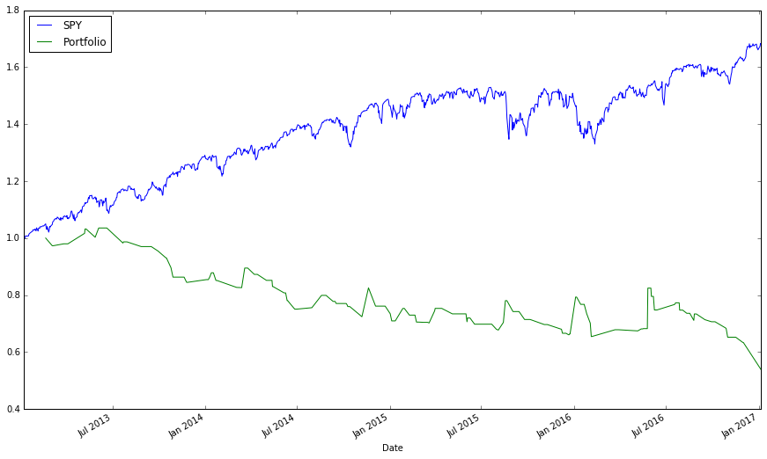
Benchmarking: Lagging Indicator
Left is: non-volatile, Fast-10 Slow-30. 110% profit.
If Tesla is not included, batch=.2 and total profit is 60%
Right is: volatile, Fast-10 Slow-30. -46% profit.

Slide 18
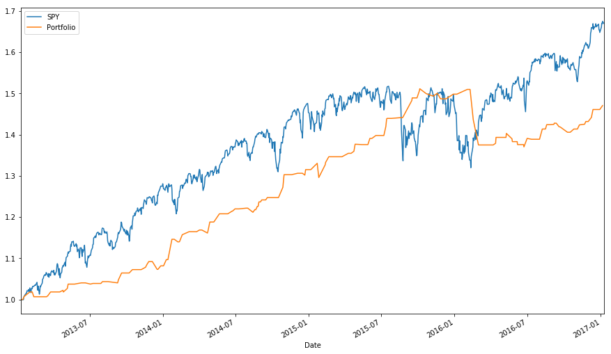
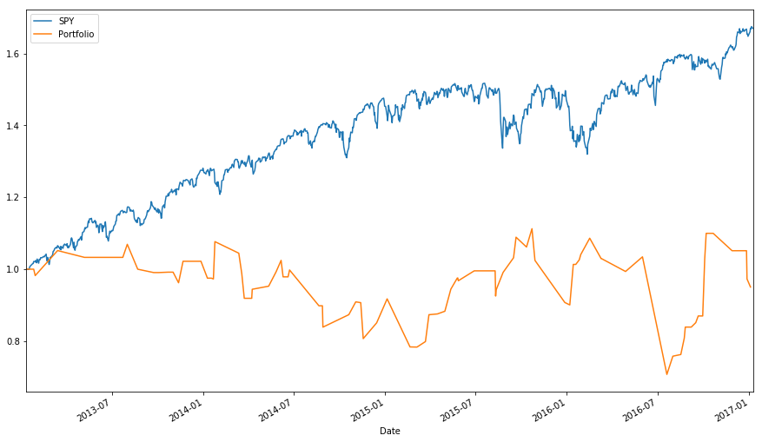
Benchmarking: Leading Indicator
Left: Non-volatile, LBP-2 boundaries 95-5. 47% profit.
Right: Volatile, LBP-2 boundaries 95-5. -5% profit.

Slide 19
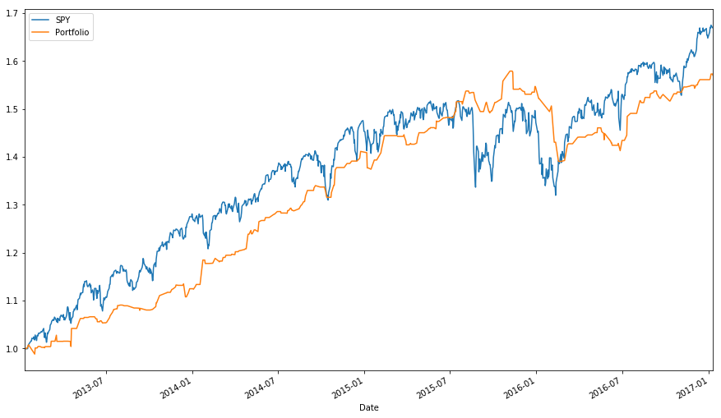
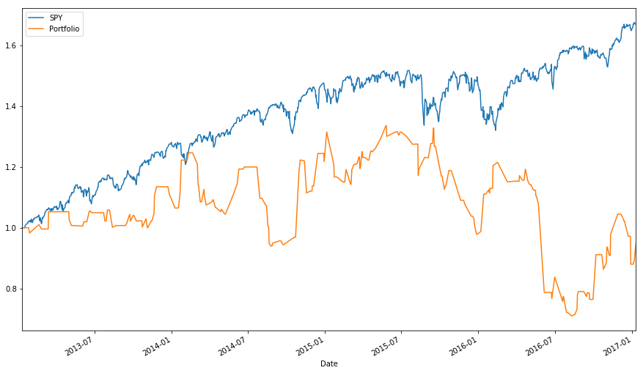
Benchmark: Strategy 3
Left: non-volatile, LBP-2 boundaries 95-5 fast MA 5 slow MA 15.
Final profit: 57%
Right: volatile, LBP-2 boundaries 95-5 fast MA 5 slow MA 15.
Final profit: -5.3%

Slide 20
Conclusion
Lagging indicators are less stable and provide higher returns in comparison to leading indicators using non-volatile stocks.
Leading indicators are better with volatile stocks compared to lagging.
Volatile stocks are unstable overall. Non-volatile are stable overall.
Volatile stocks and technical indicators do not mix well.
When not using commission fees it is best to use day trade parameters in general, but not 100% always.
each stock should have their own trade strategies parameters customized
Beating the market is possible, but not through these approaches.

